Slide 1
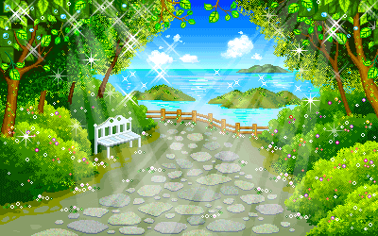
Warmly welcome to our class
Teacher: Nguyen Thi HongVan

Slide 2


Unit 4: MY NEIGHBOURHOOD
Lesson 5:Skills 1

Slide 3
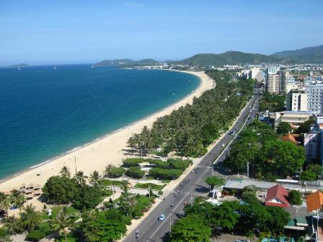
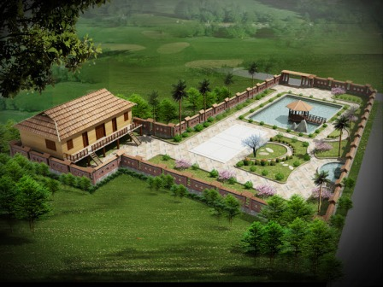

Slide 4

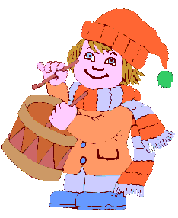


people
weather
Khang’s neighbourhood
streets
Activities
……
…..

Slide 5

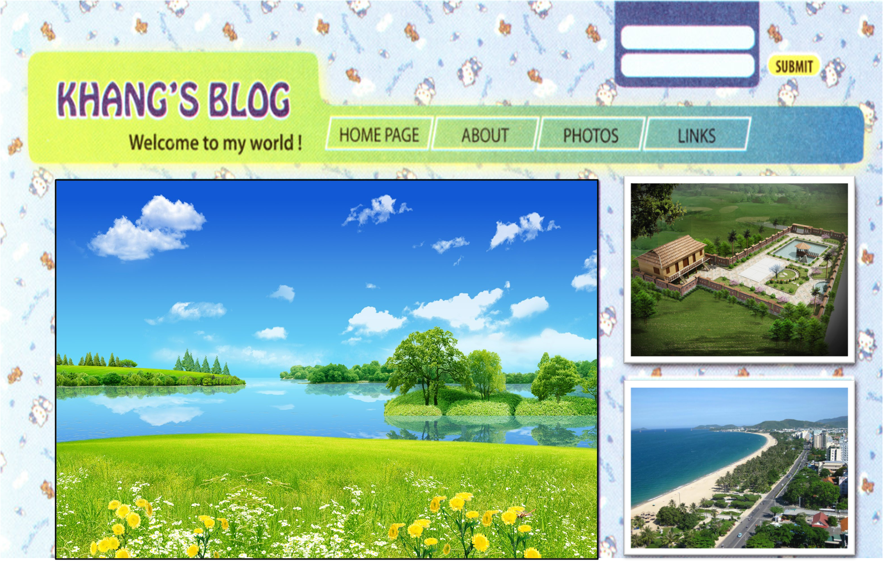
II. READING
1/ Vocabulary
suburbs backyard dislike incredibly beaches
Friday, December 23,.......
MY NEIGHBOURHOOD
I’m back home now. Hoi An was great! My neighbourhood’s very different. It’s in the suburbs of Da Nang City. There are many things I like about it.
It’s great of outdoor activities because it has beautiful parks, sandy beaches, and fine weather. There’s almost everything I need here: shops, restaurants, and markets. Every house has a backyard and a frontyard. The people here are incredibly friendly. They’re friendlier than those in many other places ! And the food’s very good.
However, there is one thing I dislike about it. Now, there are many modern buildings and offices so the streets are busy and crowded during the day.
Can anyone write about what you like and don’t like about your neighbourhood ?
Posted by Khang at 4:55 PM

Slide 6
1/ Vocabulary
suburbs backyard dislike incredibly beaches
Friday, December 23,.......
MY NEIGHBOURHOOD
I’m back home now. Hoi An was great! My neighbourhood’s very different. It’s in the suburs of Da Nang City. There are many things I like about it.
It’s great of outdoor activities because it has beautiful parks, sandy beaches, and fine weather. There’s almost everything I need here: shops, restaurants, and markets. Every house has a backyard and a frontyard. The people here are incredibly friendly. They’re friendlier than those in many other places ! And the food’s very good.
However, there is one thing I dislike about it. Now, there are many modern buildings and offices so the streets are busy and crowded during the day.
Can anyone write about what you like and don’t like about your neighbourhood ?
Posted by Khang at 4:55 PM

Slide 7
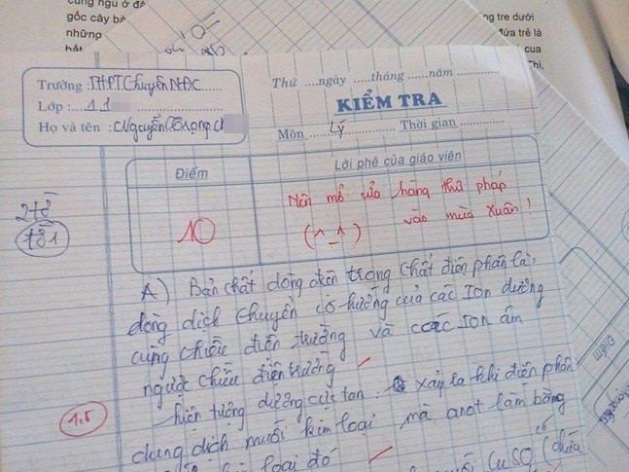
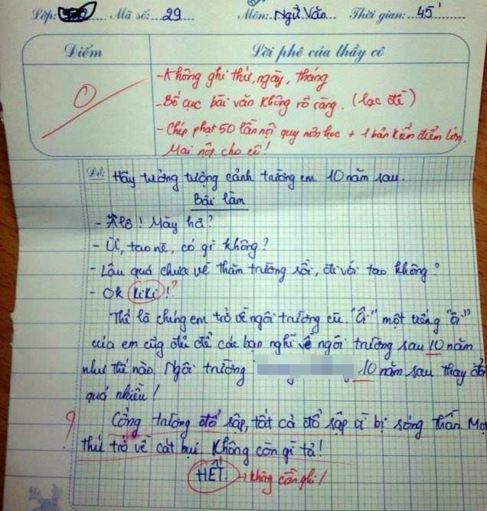

Slide 8
Beach

Slide 9
1. Vocabulary
- suburb (n)
ngoại ô
- backyard (n)
sân sau
- dislike (v)
không thích
- incredibly (adv)
vô cùng, thật ngạc nhiên
- beach (n)
bãi biển

Slide 10
2.Read Khang’s blog again and fill in table
LIKE | DISLIKE

Slide 11
2/Read Khang’s blog again and fill in table
LIKE | DISLIKE
- It’s great for outdoor activities.
The streets are busy
and crowded during the day.
- There’s almost everything here.
Most houses have a backyard and a
frontyard.
- The people are incredibly friendly.
- The food is very good.

Slide 12
3. Answer the questions.
Friday, December 23,.......
MY NEIGHBOURHOOD
I’m back home now. Hoi An was great! My neighbourhood’s very different. It’s in the suburbs of Da Nang City. There are many things I like about it.
It’s great of outdoor activities because it has beautiful parks, sandy beaches, and fine weather. There’s almost everythingI need here: shops, restaurants, and markets. Every house has a backyard and a frontyard. The people here are incredibly friendly. They’re friendlier than those in many other places ! And the food’s very good.
However, there is one thing I dislike about it. Now, there are many modern buildings and offices so the streets are busy and crowded during the day.
Can anyone write about what you like and don’t like about your neighbourhood ?
Posted by Khang at 4:55 PM
1.Where is Khang’s neighbourhood ?
2. Why is his neighbourhood great for outdoor activities ?
3. What are the people there like ?
4. Why are the streets busy and crowded ?
-> It’s in the suburbs of Da Nang City.
-> Because it has beautiful parks, sandy beaches, and fine weather.
-> The people here are incredibly friendly.
-> Because there are many modern buildings and offices.

Slide 13

III. SPEAKING

Slide 14
Ask for directions
1.Excuse me! Can you tell me the way to the cinema?
2.Where is the cinema?
Give directions
1.Turn right / left
2.Go straight on
3. Go along the street
4.Go past the bus stop
5.Cross the street
6. Take the first turning on the left
Respond
-you’re welcome!
-No problem!
-My pleasure.
Thanks

Slide 15
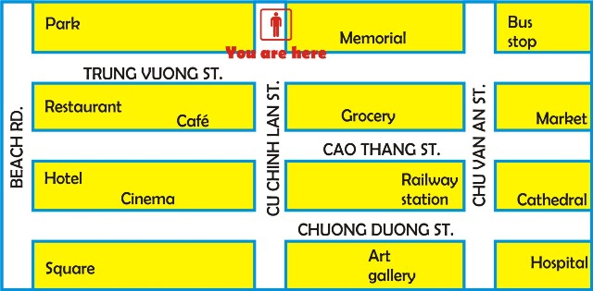
III. SPEAKING
Ex: 4 Ask and answer questions about how to get to the places on the map.
Example: A: Excuse me. Can you tell me the way to the beach?
B: Yes. First, go straight. Then turn right. After that go straight again.
It’s in front of you.
A: Thank you very much.
Market
Railway
Station
Art gallery
Square

Slide 16



IV.HOMEWORK
Write each word 2 lines
Ex: 5 Make a short dialogue about how to get to 3 places near your school
Prepare SKILLS 2

Slide 17


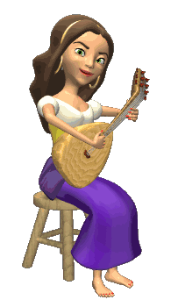


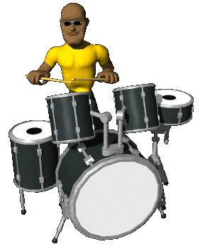





THANK YOU FOR ATTENTION!
GOOD BYE!
the end

